Slide 1
CES 361
Fundamentals of
Software Testing
Session 1

Slide 2

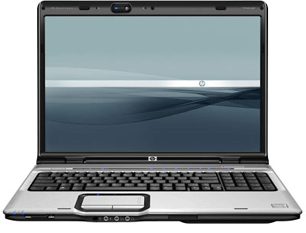
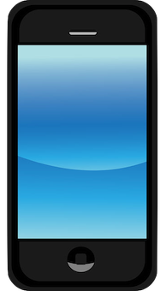
Let’s get started on the right foot...

Slide 3
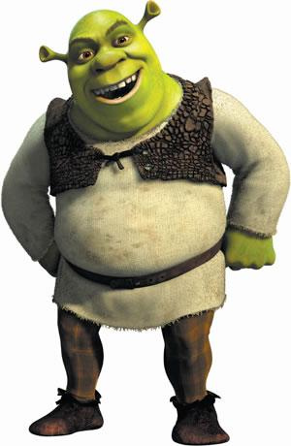
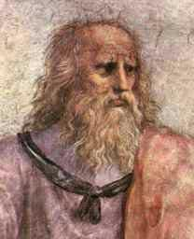
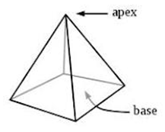
Who is This?
Who Am I?
What is the Socratic Method?
Remember your geometry?

Slide 4
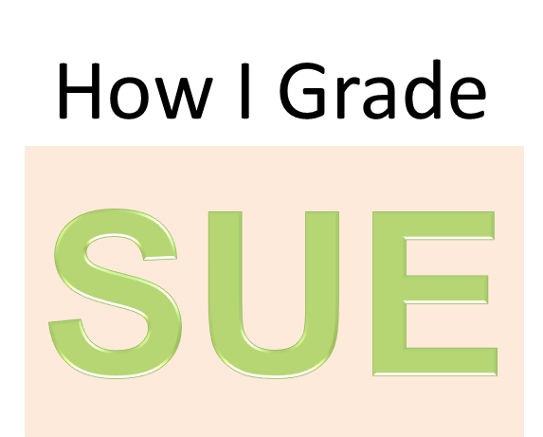
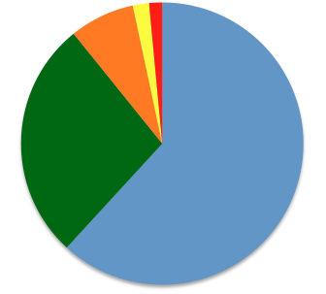
My Grading History
Since 2005:
33 Courses
537 Students
A | B | C | D | F
332 | 147 | 40 | 10 | 8
61.8% | 27.4% | 7.4% | 1.9% | 1.5%
Standard Disclaimer: Past Performance is No Guarantee of Future Results

Slide 5
Software Testing Socratic Questions
Why do software errors happen?
        2 kinds; one of which is a primary focus
When do software errors happen?
        every bug has a beginning and an end
Where do software errors happen?
        where in the code? (interfaces)
How do software errors happen?
        should be at least 6 or so

Slide 6
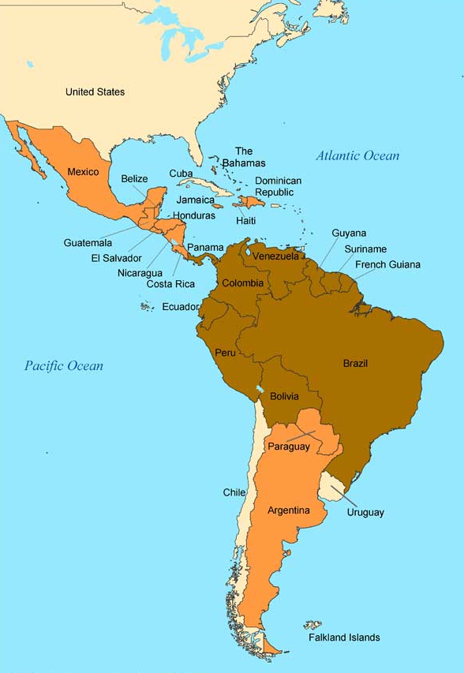
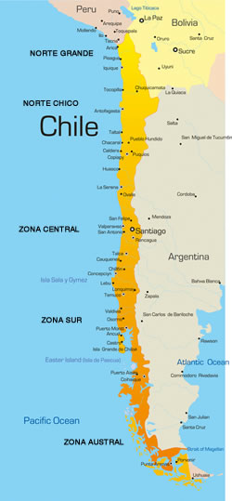
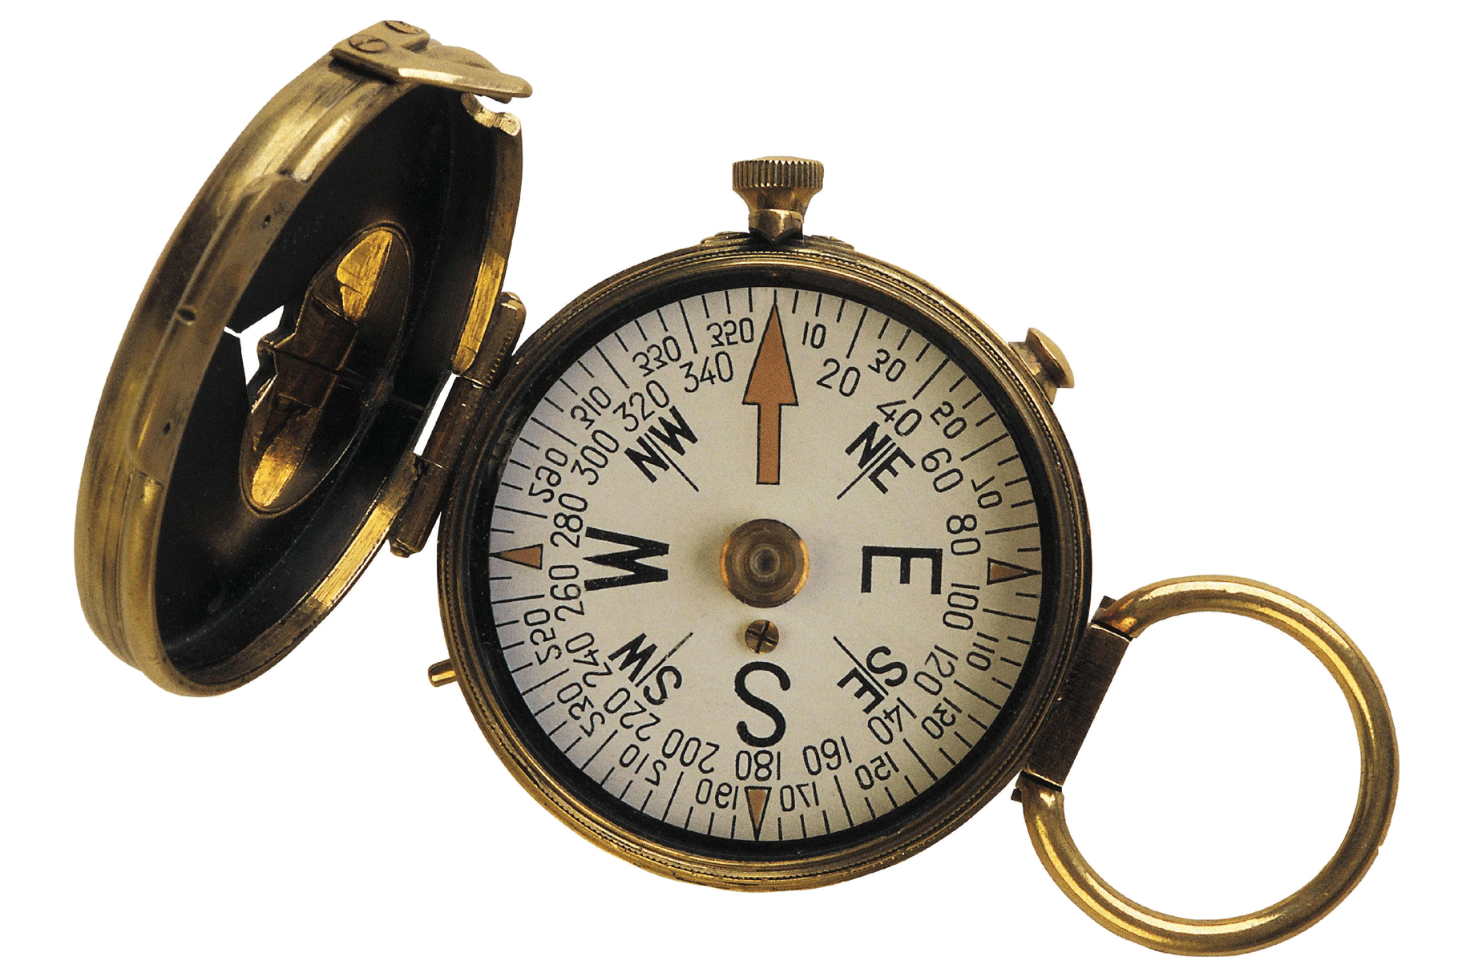

Glitch of the Day:
South American Geography

Slide 7
What Do We Know About Testing?
What is the difference between a test case, and a test plan?
What are the components of a test case?

Slide 8
What Do Test Cases Look Like?
Input
Expected Output
Actual Output
___ P ___ F (depending on actual output)
In general, four components per case. What are they?
For example:
Collect the quiz scores and calculate the average,
not including the lowest score.
Test Case 1
Input: 80, 83, 88, 91
Expected Out:
Actual Output:
What is the expected output?
87.3333333333

Slide 9
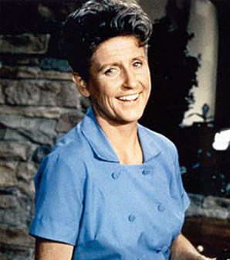
Who Is This?
Test Case 1
Input: 80, 83, 88, 91
Expected Out: Average of the
3 highest scores
Actual Output:
Test Case 1
Input: 80, 83, 88, 91
Expected Out: 87.3
Actual Output:

Slide 10

Fill in the Blank
To construct your test cases,
you need to have _________

Slide 11
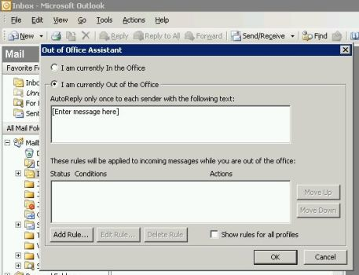
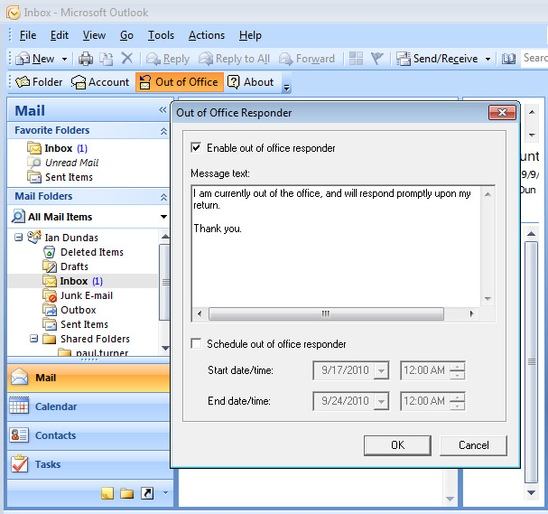
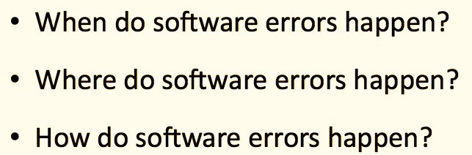
Does This “Meet Requirements”?
What is the requirement?
Is this a bug?
What is wrong with this picture?
Outlook shall have the capability to automatically send “out-of-office” replies
when a user is not available for a prolonged time.

Slide 12
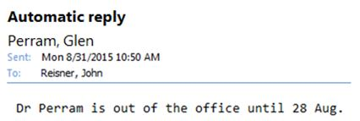
and earlier today…

